Slide 1
JNCIS-ENT
High Availability (HA)

Slide 2
LAGs and RTGs
3
Link Aggregation and Redundant Trunk Groups

Slide 3

What is a Link Aggregation Group
Link aggregation grouping or link bundling is the act of combining multiple physical interfaces to create a single logical interface at the link layer
Defined in IEEE 802.3ad
Has benefits for throughput and availability
Member links of the aggregate may be removed without the aggregate going down
Traffic is load balanced across member links to increase the available bandwidth
The link that a particular frame is sent over is determined by hashing the header information
Load balancing of IP traffic hashes layer 2, layer 3 and layer 4 data by default
Non-IP traffic load balancing only uses layer 2 information
Traffic originating from the RE of the Junos device will always take the lowest interface number

Slide 4
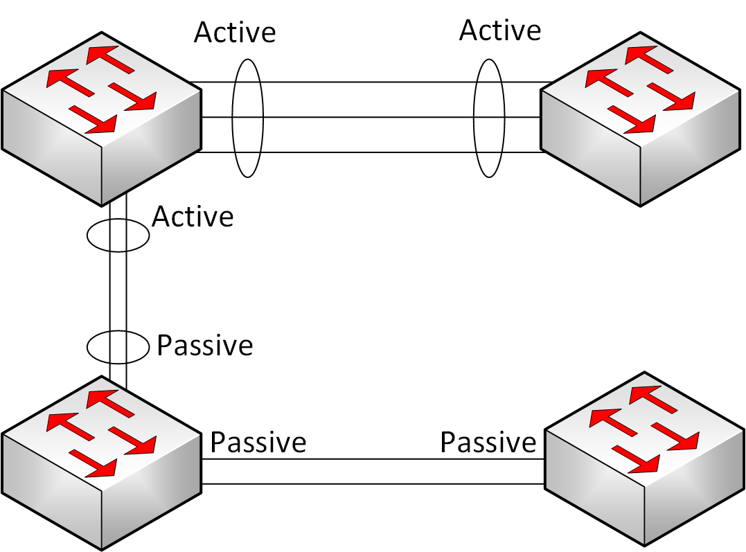
What is LACP
Link Aggregation Control Protocol allows for the automatic addition and deletion of links to a LAG
Control frames are sent from each member interface to dynamically negotiate the LAG interface
LACP has a concept of ‘active’ interfaces and ‘passive’ interfaces
A passive interface will not originate control frames, though it will respond to them
At least one side of a link must be configured as an LACP active interface for the successful LAG negotiation

Slide 5
Configuring LAGs and LACP
Aggregate Ethernet (ae) interfaces are not present by default
The must be configured under the [edit chassis] hierarchy first
An ae interface will be operationally down until LACP successfully negotiates
{master:0}[edit]
lab@SW1# run show interfaces terse | match ae
{master:0}[edit]
lab@SW1# set chassis aggregated-devices ethernet device-count 2
{master:0}[edit]
lab@SW1# commit
commit complete
{master:0}[edit]
lab@SW1# run show interfaces terse | match ae
ae0 up down
ae1 up down

Slide 6
Configuring LAGs and LACP Cont.
{master:0}[edit]
lab@SW1# set interfaces ae0.0 family ethernet-switching vlan members default
{master:0}[edit]
lab@SW1# set interfaces ae0.0 aggregated-ether-options lacp active
{master:0}[edit]
lab@SW1# set interfaces ge-0/0/1 ether-options 802.3ad ae0
{master:0}[edit]
lab@SW1# set interfaces ge-0/0/2 ether-options 802.3ad ae0
{master:0}[edit]
lab@SW1# commit
commit complete
{master:0}[edit]
lab@SW1# run show interfaces terse | match ae0
ge-0/0/1.0 up up aenet --> ae0.0
ge-0/0/2.0 up up aenet --> ae0.0
ae0 up up
ae.0 up up eth-switch

Slide 7
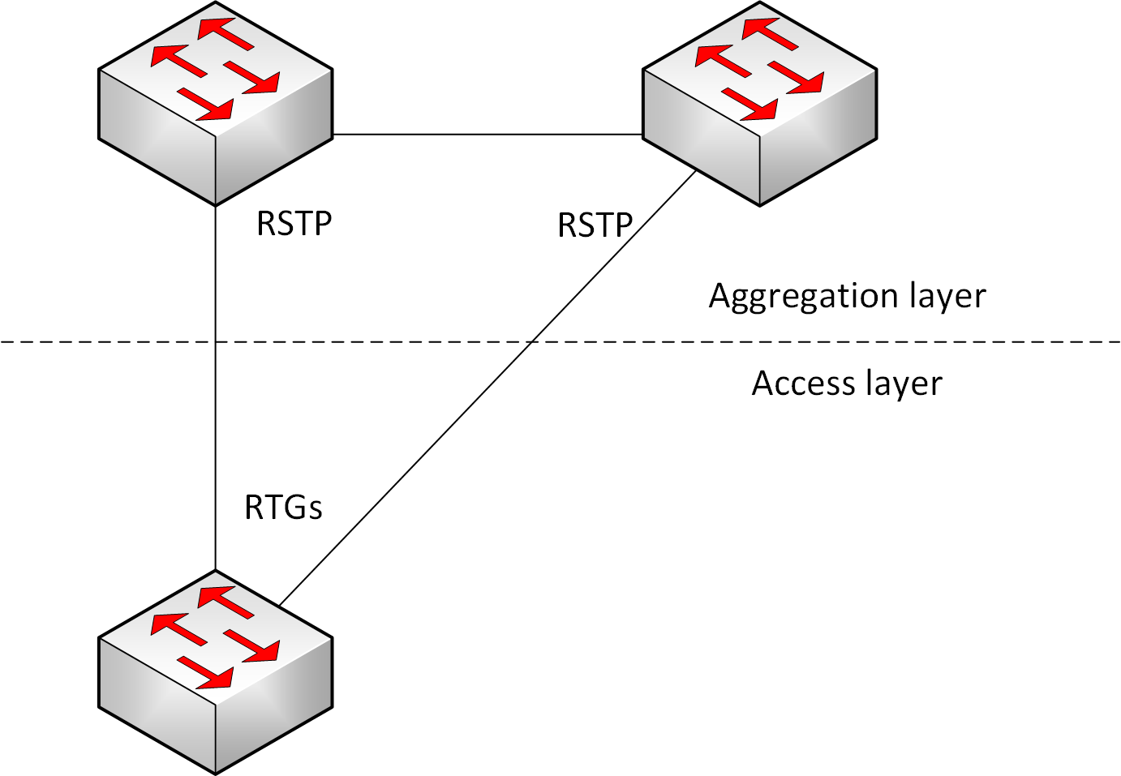
What is a Redundant Trunk Group
RTGs or Redundant Trunk Groups provide an alternative to STP for switch uplinks
RTGs can failover faster than Spanning Tree Protocol
RTGs may be used on a maximum of 2 uplinks, one primary and one backup
Spanning Tree Protocol must not be running on the interface for an RTG to be configured
User traffic is blocked on the backup link until a failover occurs
L2 control traffic such as LACP and LLDP are still received and exchanged on the backup
RTGs are typically only configured at the access layer

Slide 8
Configuring RTGs
Both interfaces in an RTG must be members of the same VLANs
Both must either be access ports or trunk ports, if trunks, they must have the same VLAN memberships
One interface must be set as the primary
The primary interface will always be active when operational
{master:0}[edit]
lab@SW1# set switch-options redundant-trunk-group group rtg1 interface ge-0/0/1.0 primary
{master:0}[edit]
lab@SW1# set switch-options redundant-trunk-group group rtg1 interface ge-0/0/2.0
{master:0}[edit]
lab@SW1# commit
commit complete

